Slide 1
E-learning Experiencia ICO - PAAO
Dr. Eduardo Mayorga
Director for E-learning

Slide 2
The Web Based Teaching Course & The Webinar Network
Dr. Eduardo Mayorga
Director for E-learning
International Council of Ophthalmology

Slide 3
Goal
Queremos e-learning !!!
Notes:
By answering to the question ¿Why webinars? my hope is that by the end of this 10 minute presentation everybody present today will walk out of this room convinced that webinars are a "must" in ophthalmic medical education.

Slide 4
Objetivo
Notes:
To help medical teachers give their first step to enter into the web- based teaching setting to enhance their teaching possibilities.

Slide 5
Contenido
Qué es el e-learning?
Los beneficios del e-learning.
Cómo podemos comenzar?
Notes:
And for this to happen we will need to:
Clearly define what a webinar is
Explain the benefits of webinars
Give some hints and guidance on how to start this experience

Slide 6
Contenido
Qué es el e-learning?
Los beneficios del e-learning.
Cómo podemos comenzar?
Notes:
And for this to happen we will need to:
Clearly define what a webinar is
Explain the benefits of webinars
Give some hints and guidance on how to start this experience

Slide 7
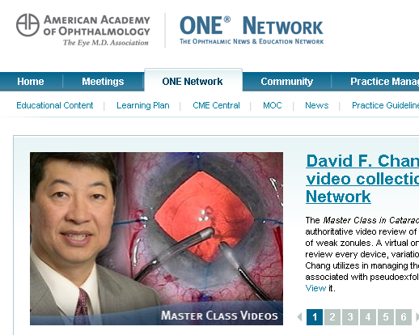
E-learning
“Cualquier intervención educativa,
que está almacenada o usa un
medio electrónico para su transmisión
y que no requiere la presencia de un profesor en el mismo espacio físico donde están los estudiantes”

Slide 8
E-learning
E-learning
Sincrónico
Asincrónico

Slide 9
E-learning
E-learning
Sincrónico
Asincrónico

Slide 10
Qué es un webinar?
Webinar
Web
Seminario
Internet
Interactivo
Notes:
The word "Webinar" comes from the combination of "web" and "seminar". this implies 3 things:
Instructor and attendants meet in a virtual place, the Internet,
at the same time.
There is interaction between the teacher and the learners. Because this is implicit in the definition of a seminar.
Interaction means 2 way communication.

Slide 11
E-learning síncrónico
Teacher
Notes:
As you must know synchronous e-learning is when teacher and learners meet through Internet at the same time.

Slide 12
La pantalla del webinar
Notes:
With webinar software you have the ability to poll big audiences get to know how many had the correct answer and even interact and get open ended answers from many learners at a time.

Slide 13
E-learning
E-learning
Sincrónico
Asincrónico

Slide 14
E-learning asincrónico
Teacher
Notes:
The course is an asynchronous e-learning course meaning by this learners and teachers are not online at the same time.

Slide 15
E-learning
E-learning
Sincrónico
Asincrónico
Autodirigido
Tutoreado

Slide 16
E-learning
E-learning
Sincrónico
Asincrónico
Autodirigido
Tutoreado

Slide 17
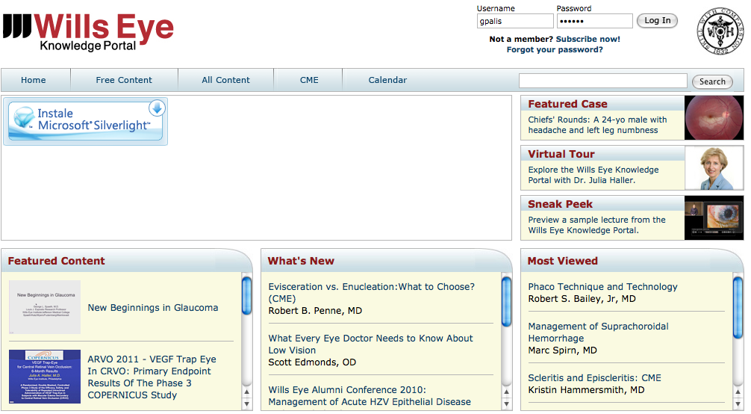
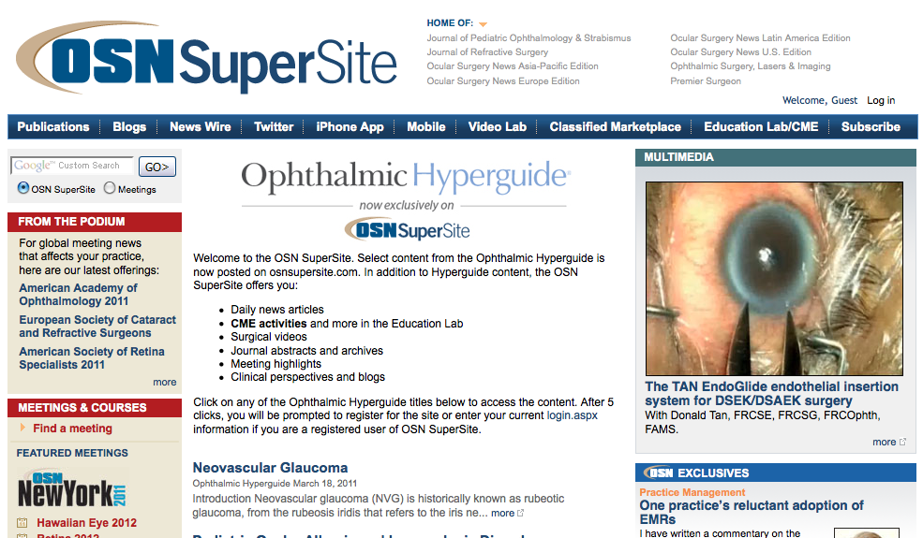
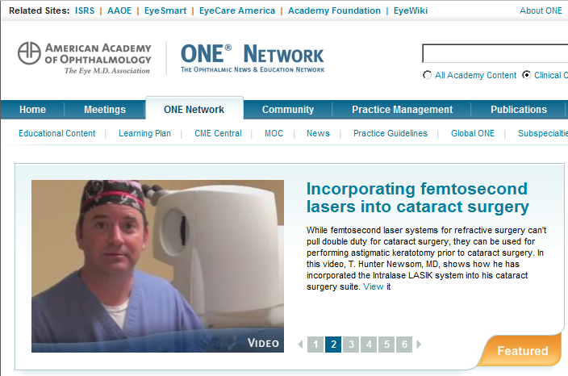
Autodirigido
Notes:
For the purpose of clarifying more the concept of "webinar" lets take a look at some counter examples to show what may look as a webinar but really it is not.
Online recorded lectures with or without discussion forums
These are not live, they are recorded and even in some of this they may be discussion using forums, these are not webinars
Online live lectures with no interaction
These may be live, but as it is just one way communication these are not considered webinars. The value of these is that they are the first necessary step to start running webinars since you go online live.

Slide 18
E-learning
E-learning
Sincrónico
Asincrónico
Autodirigido
Tutoreado

Slide 19
ICO’s “Web Based Teaching” course
Week 1
Week 3
Week 5
Week 2
Week 4
Week 6

Slide 20
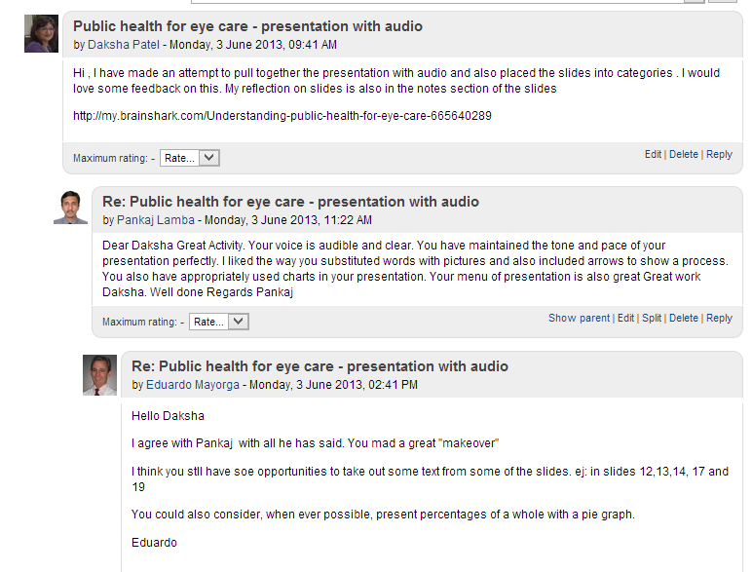
Diapo foro wbt

Slide 21
Participo como asistente en webinars
Frecuentemente
Pocas veces
Nunca

Slide 22
He disertado en webinars
Frecuentemente
A veces
Nunca

Slide 23
He participado como asistente en un curso asincrónico
Frecuentemente
Algunas veces
Nunca

Slide 24
Soy docente en cursos asincrónicos
Frecuentemente
Algunas veces
Nunca

Slide 25
Contenido
Qué es el e-learning?
Los beneficios del e-learning.
Cómo podemos comenzar?
Notes:
And for this to happen we will need to:
Clearly define what a webinar is
Explain the benefits of webinars
Give some hints and guidance on how to start this experience

Slide 26
Razones para incorporar e-learning
Need to be more efficient
Allows more interaction
Need to expand to more languages
Notes:
Now that we have clear what we mean by webinars let us take a look at the 3 main reasons why we really need to incorporate this teaching strategy into our teaching toolbox.

Slide 27
Razones para incorporar e-learning
Ser más eficientes
Allows more interaction
Need to expand to more languages
Notes:
Now that we have clear what we mean by webinars let us take a look at the 3 main reasons why we really need to incorporate this teaching strategy into our teaching toolbox.

Slide 28
Ser más eficientes
Notes:
Number 1
We need to be more efficient and more effective when teaching our residents.
How can we be more efficient and effective?
Every year hundreds of residency programs teach small groups of residents the same topics.
We could save many hours of teacher's time if just we could get some of these residencies working together in a way that more residents could attend the same lecture.
This would not only free up time of teachers that they could devote to preparing other teaching interventions but we could also choose the best teachers to address our learners.

Slide 29
Más eficientes: Tiempo de los profesores

Slide 30
Necesitamos ser mas eficientes
Notes:
Number 1
We need to be more efficient and more effective when teaching our residents.
How can we be more efficient and effective?
Every year hundreds of residency programs teach small groups of residents the same topics.
We could save many hours of teacher's time if just we could get some of these residencies working together in a way that more residents could attend the same lecture.
This would not only free up time of teachers that they could devote to preparing other teaching interventions but we could also choose the best teachers to address our learners.

Slide 31
Razones para incorporar e-learning
Ser más eficientes
Ser más eficaces
Need to expand to more languages
Notes:
Now that we have clear what we mean by webinars let us take a look at the 3 main reasons why we really need to incorporate this teaching strategy into our teaching toolbox.

Slide 32
E-learning
E-learning más eficaz que presencial
Notes:
On September 2009 a report from the Us Department of Education, that was drawn to my attention by Bill, came up with this report that, concluded: Online better than face to face.
My question was: what has online learning that makes it better than face to face?
Lets see some concepts that can help answer this question.

Slide 33
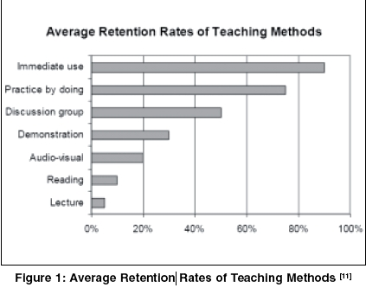

Slide 34
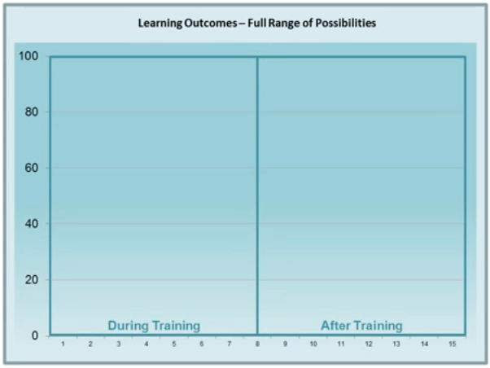
Deseada Desired

Slide 35
Usual Usual
?
?

Slide 36
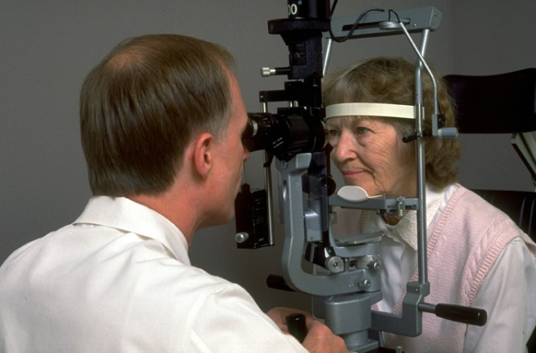
Procesamiento
Incorporar
Procesar
Almacenar
Evocar
Transferencia
Aplicar
Notes:
An added value I found in webinars is that it changed the way we prepared lectures.
As you probably all know lectures is one of the most ineffective ways of teaching because a one way lecture where the teacher speaks and the learners learn holds only one of the fazes of the process of learning: the transference faze. For learning to occur you also need the learner incorporate, process, retrieve and be able to apply what he learned.

Slide 37
Dificultades para usar interactividad
Bla..bla
?
?
?
?
Notes:
One way of doing this is with interaction. Even though interaction can be achieved on face to face lectures, if you ask a question and one answers you never get to know if the rest knew or not.

Slide 38
Interactividad en webinars
Notes:
With webinar software you have the ability to poll big audiences get to know how many had the correct answer and even interact and get open ended answers from many learners at a time.

Slide 39
Interactividad en asincrónicos

Slide 40
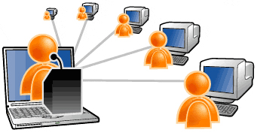
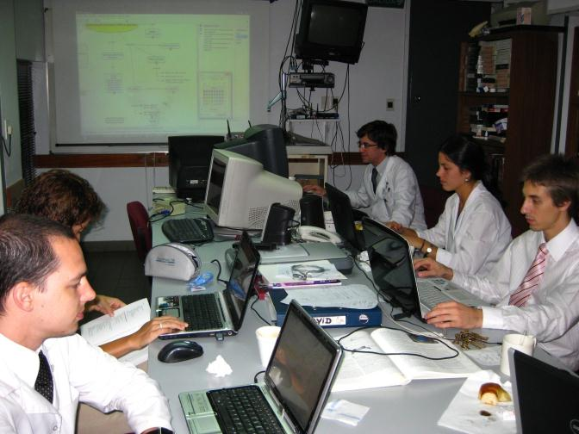
Notes:
Since we started with webinars even when we don´t have others learners connected, we still have our residents interacting answering and voting through their computers, tablets or smart phones.

Slide 41
Razones para incorporar e-learning
Más eficientes
Mas interacción
Más idiomas
Notes:
Now that we have clear what we mean by webinars let us take a look at the 3 main reasons why we really need to incorporate this teaching strategy into our teaching toolbox.

Slide 42
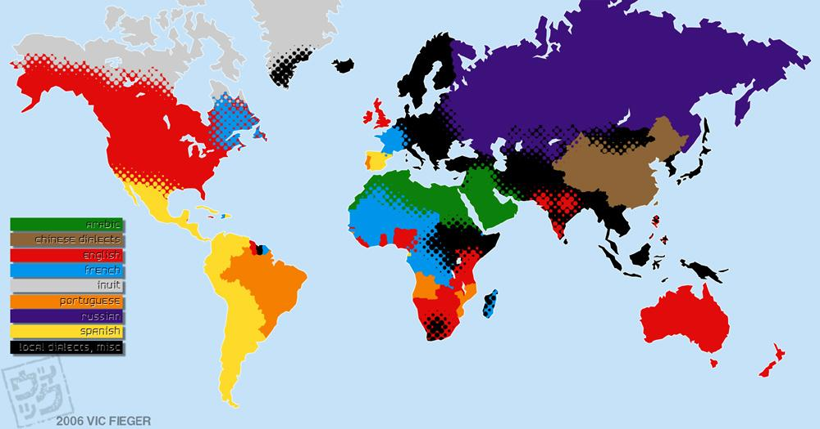
Notes:
Let's see now the last reason.
Most of e-learning activities, whether they are asynchronous or synchronous are in English.
If you are a teacher and your first language is not English you need the most to run webinars because probably in your country many doctors don't speak English well enough to attend online English webinars.
Only a part of the world speaks English and a lot of non English speakers are left outside.

Slide 43
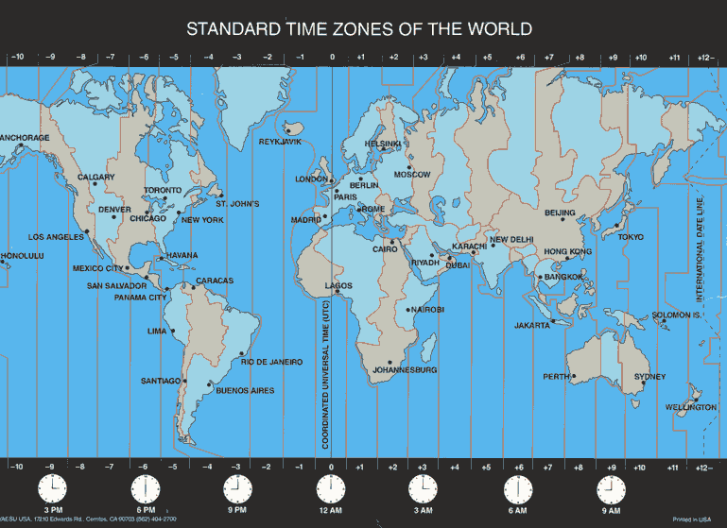
Qué pasa con las zonas horarias?
Notes:
What if you cannot attend a webinar.
Time zones may make very difficult for everybody interested in a webinar to be able to attend it.
Almost every webinar software has incorporated the ability to record it for later attendance.
The ability to pause the replay at the interactivity points allows asynchronous participants still be able to elaborate on the questions and quizzes posted by the speaker

Slide 44
Grabación de webinars

Slide 45
Grabación Webinars: Interactividad?
?

Slide 46
Contenido
Qué es e-learning?
Los beneficios del e-learning.
¿Cómo podemos empezar?
Notes:
And for this to happen we will need to:
Clearly define what a webinar is
Explain the benefits of webinars
Give some hints and guidance on how to start this experience

Slide 47
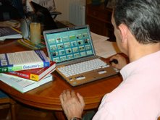
Crear e-learning
Diseñadores instruccionales
Desarrolladores web
Notes:
Let´s take a look at some differences between online teaching and face to face.
When we teach face to face we usually do it on the run, with no preparation at all or, when conferencing, we prepare our talks alone with our computers, concentrating mostly on content.
When preparing an online teaching experience there is a team behind it, that can include pedagogues, instructional designers, web developers, content experts.
Let us see why being a content expert is not enough fot teaching.

Slide 48
Crear e-learning
Diseño instruccional
Software bajo costo o gratuito
Notes:
Let´s take a look at some differences between online teaching and face to face.
When we teach face to face we usually do it on the run, with no preparation at all or, when conferencing, we prepare our talks alone with our computers, concentrating mostly on content.
When preparing an online teaching experience there is a team behind it, that can include pedagogues, instructional designers, web developers, content experts.
Let us see why being a content expert is not enough fot teaching.

Slide 49
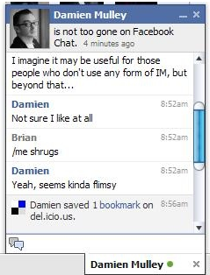
Puedo hacer esto?
Notes:
At this time you may be asking yourselves. Can I do this? Isn't this too complicated.
I bet most of you are ready.
If you are able to create presentations with PowerPoint, send SMS messages with your phone, answer an online survey, communicate using Skype, then you have tried all the ingredients of webinar software.

Slide 50
Webinar environment
Notes:
This is the webinar environment with which we work and as you see it has all the components that I mentioned.
PowerPoint
Audio and video as in Skype
Chat windows that simulate

Slide 51
The Web Based Teaching Course & The Webinar Network
Dr. Eduardo Mayorga
Director for E-learning
International Council of Ophthalmology

Slide 52
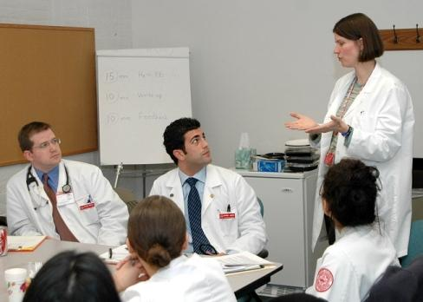
What we planned.
Poner imagen de como enseñamos : clase, clínica cirugía pequeños
Grupos
Tal vez segunda diapo con los últimos 2 párrafos
Notes:
In 2011 we decided to expand our face to face activities to the web.
We took a look at where we could have the higher impact and, as lectures was one of the most used strategies to teach not only during residency training but specially in CME we decided to work on this
Our goal was to make lectures more effective and at the same time help good lectures get to more learners.

Slide 53
E-learning Asincrónico
Profesor

Slide 54
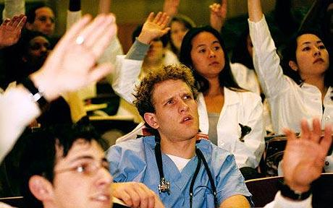
Módulos
Teorías aprendizaje del adulto
Captar
Mantener atención
Facilitar aprendizaje
Planning a Course
Foto de dormido a atento
Building Course Content
Multimedia Principles
Multimedia Tools

Slide 55
Módulos
Teorías aprendizaje del adulto
Escribir metas y objetivos
Organizar el contenido
Desarrollar evaluaciones
Imagen de blanco
Planear un curso
Building Course Content
Multimedia Principles
Multimedia Tools

Slide 56
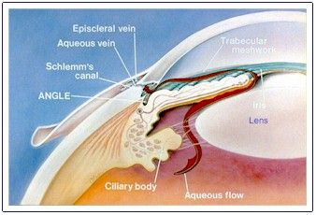
Módulos
Teorías aprendizaje del adulto
Planear un curso
Hechos
Conceptos
Procedimientos
Procesos
Principios
Armar el contenido
Multimedia Principles
Multimedia Tools

Slide 57
Módulos
Teorías aprendizaje del adulto
Imagen de video y gráficos
Planear un curso
Armar el contenido
Psicología cognitiva
Combinación de multimedia
Aprendizaje efectivo
Principios multimedia
Herramientas multimedia

Slide 58
Módulos
Teorías aprendizaje del adulto
Planear un curso
Armar el contenido
Principios multimedia
Presentaciones online
Cuestionarios
Actividades interactivas
Herramientas multimedia

Slide 59
The tutors
Gabriela
Palis
Helena
Felipe
Andrew
Lee
Karl
Golnik
Eduardo
Mayorga

Slide 60
Desarrollo
Week 1
Week 3
Week 5
Week 2
Week 4
Week 6

Slide 61
Actividades
Presentaciones audiovisuales
Presentar nuevo conocimiento

Slide 62
Actividades
Presentaciones audiovisuales
Presentar nuevo conocimiento
Lecturas recomendadas
Artículos y libros

Slide 63
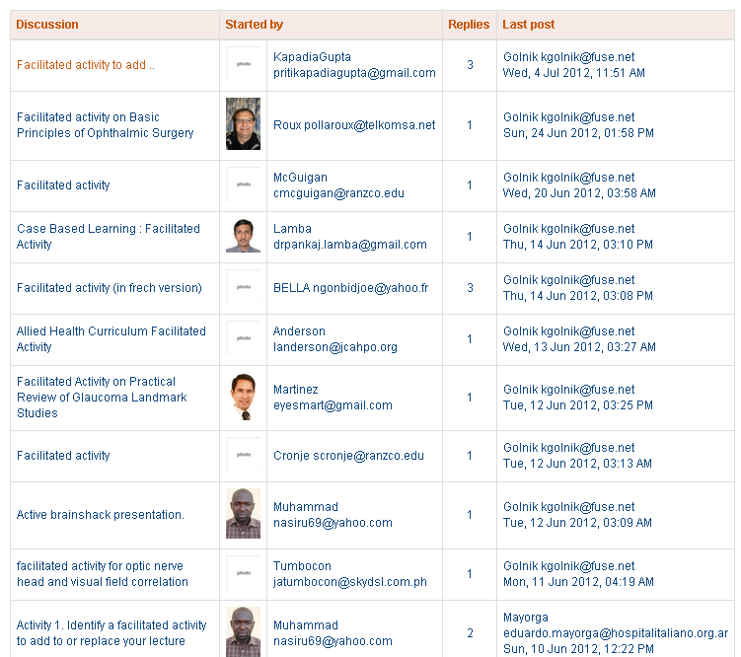
Actividades
Presentaciones audiovisuales
Presentar nuevo conocimiento
Lecturas recomendadas
Artículos y libros
Foros de discusión
Preguntas y discusiones
Foros de reflexión
Aprendizaje y aplicación

Slide 64
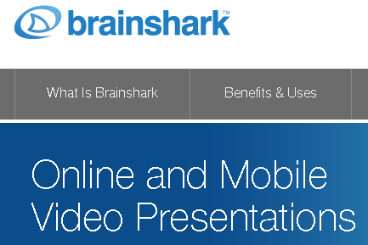
Actividades
Presentaciones audiovisuales
Presentar nuevo conocimiento
Lecturas recomendadas
Artículos y libros
Foros de discusión
Preguntas y discusiones
Foros de reflexión
Aprendizaje y aplicación
Ejercitación práctica
Crear de principio a fin
Práctica con el software de desarrollo

Slide 65
The Webinar Network

Slide 66
Repositorio
Webinars
Futuros
Guias
Webinars
pasados
Sitio
Web

Slide 67
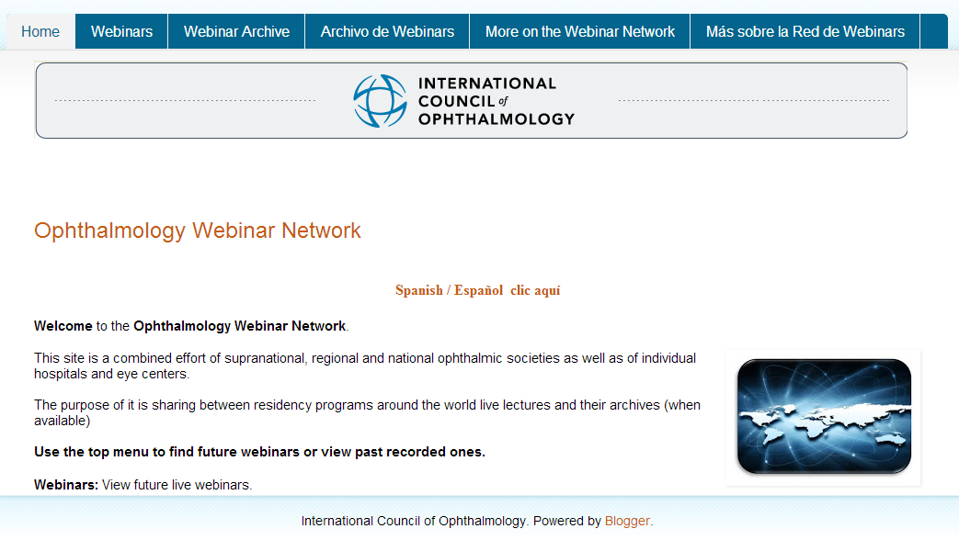
The Webinar Project
Imagen de webinar site
Notes:
Webinars have been around for a time in ophthalmology but it is not yet an everyday activity in residencies.
We believe it should, and for this we have already set up a site where we have
Setup some basic guidelines for preparing content for webinars
Started a directory for live and recorded webinars
Offer assistance to eye departments for starting their own webinars.

Slide 68
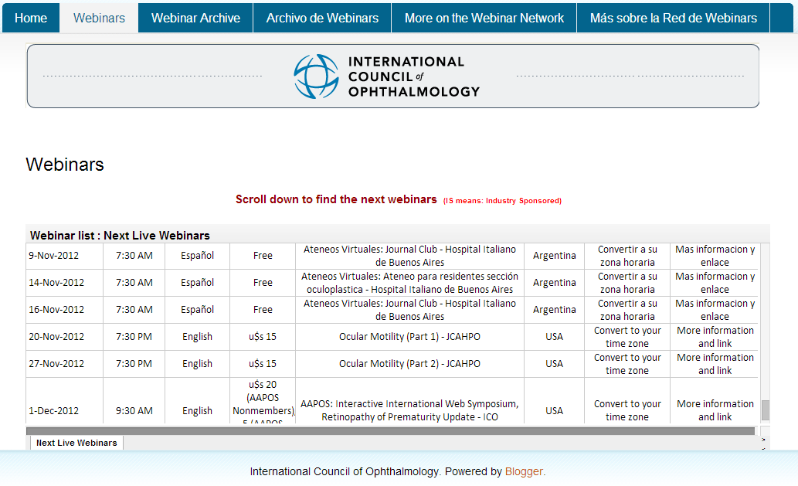
The Webinar Project

Slide 69
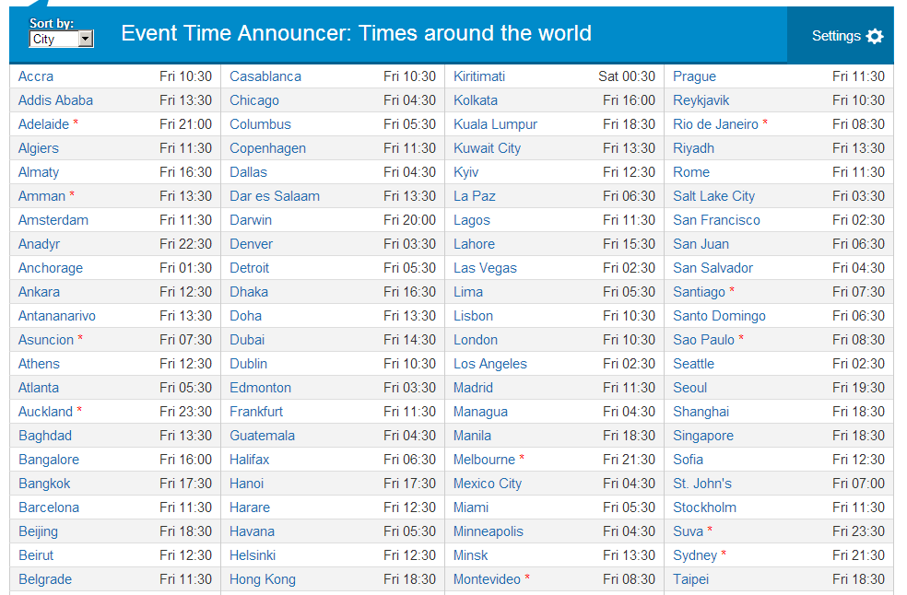

Slide 70
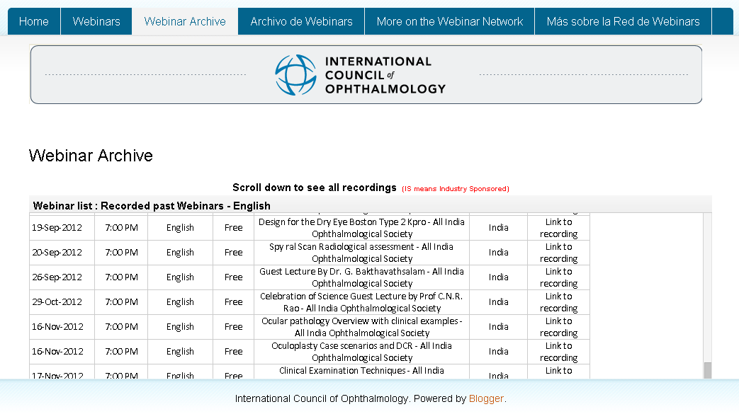

Slide 72
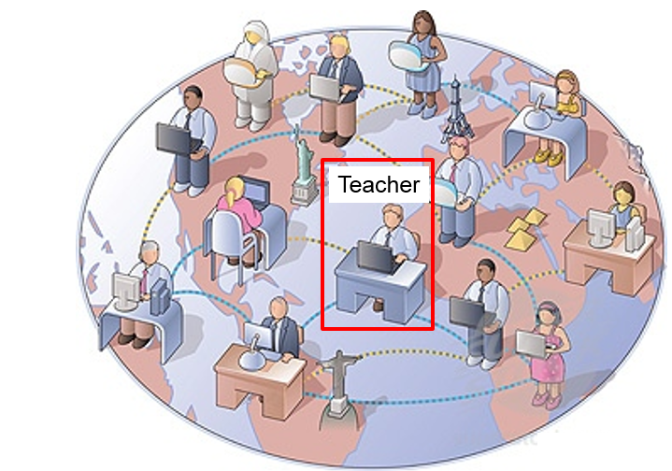
Synchronous E-learning

Slide 73
How it works
Week 1
Week 3
Week 5
Week 7
Week 2
Week 4
Week 6
Week 8

Slide 76
Informal training
Matt Gearinger, USA
Eduardo Viteri, Ecuador
Sandra Brenes, USA
Anahi Lupinacci, Argentina
Luis Gonzalez, Paraguay

Slide 77
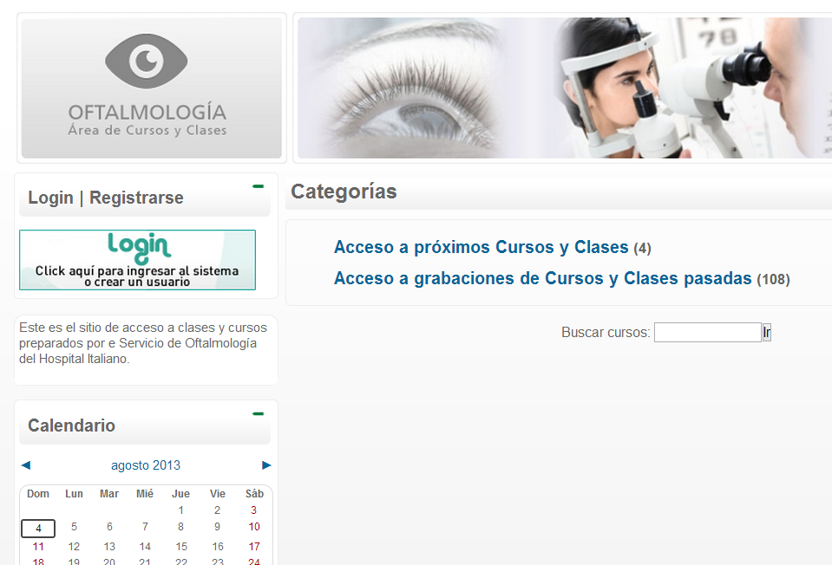
Resultados
Notes:
http://campus.oftalmohi.com/

Slide 78
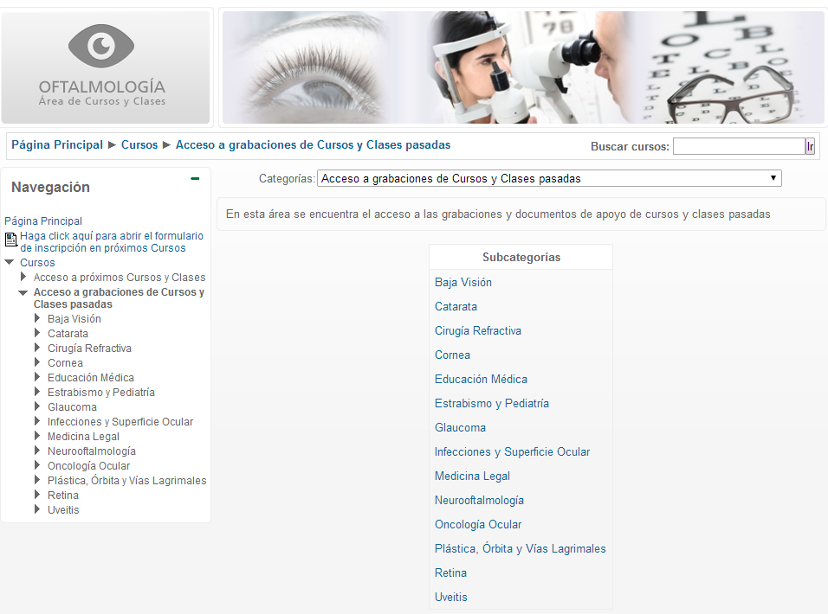

Slide 79
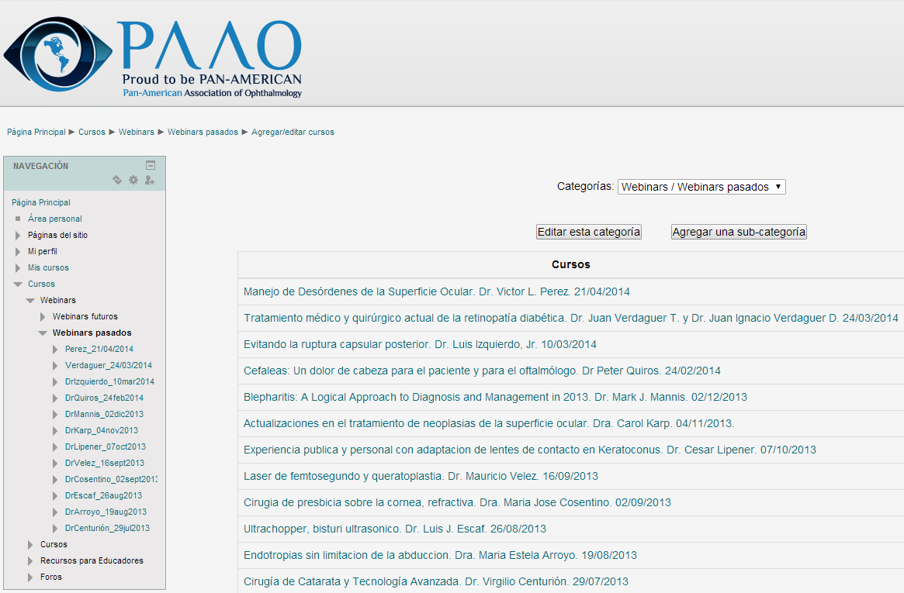

Slide 80
Conclusiones
E-learning mejor que presencial

Slide 81
Procesamiento
Incorporar
Procesar
Almacenar
Evocar
Transferencia
Aplicar
Notes:
An added value I found in webinars is that it changed the way we prepared lectures.
As you probably all know lectures is one of the most ineffective ways of teaching because a one way lecture where the teacher speaks and the learners learn holds only one of the fazes of the process of learning: the transference faze. For learning to occur you also need the learner incorporate, process, retrieve and be able to apply what he learned.

Slide 82
Crear e-learning
Diseñadores instruccionales
Desarrolladores web
Notes:
Let´s take a look at some differences between online teaching and face to face.
When we teach face to face we usually do it on the run, with no preparation at all or, when conferencing, we prepare our talks alone with our computers, concentrating mostly on content.
When preparing an online teaching experience there is a team behind it, that can include pedagogues, instructional designers, web developers, content experts.
Let us see why being a content expert is not enough fot teaching.

Slide 83
Developing e-learning
Instructional design
Free or
low cost software
Notes:
Let´s take a look at some differences between online teaching and face to face.
When we teach face to face we usually do it on the run, with no preparation at all or, when conferencing, we prepare our talks alone with our computers, concentrating mostly on content.
When preparing an online teaching experience there is a team behind it, that can include pedagogues, instructional designers, web developers, content experts.
Let us see why being a content expert is not enough fot teaching.

Slide 84
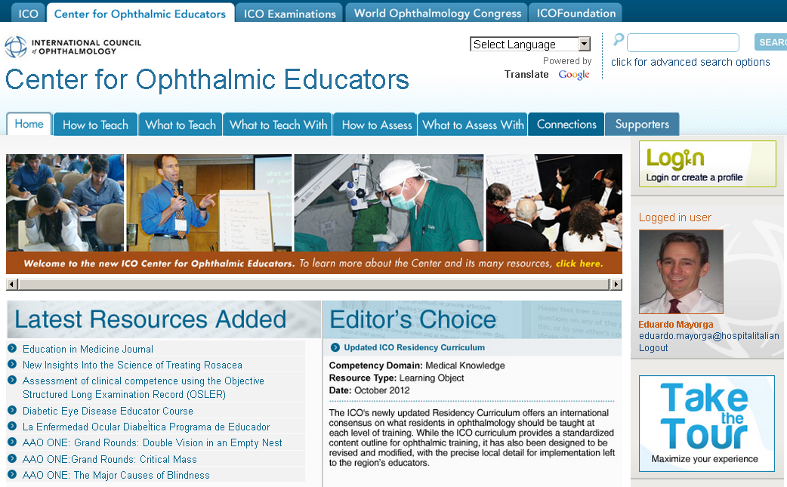
¿Cómo puedo empezar?
elearning@icoph.com
Notes:
If you have bought into the webinar idea but don't know how to start, contact us at the ICO. We will guide you and help you set up your webinars

